Slide 1
Reflections on research, policy and practice on inequality
By Finn Tarp
Development Economics Research Group (DERG)
Exploratorium 18 March 2021

Slide 2
A few references
World Development Report 2006
http://documents1.worldbank.org/curated/en/435331468127174418/pdf/322040World0Development0Report02006.pdf
UNU-WIDER Conference Inequality, Measurement, Trends, Impacts, and Policies
https://www.wider.unu.edu/event/inequality-measurement-trends-impacts-and-policies
The Stockholm Statement https://www.wider.unu.edu/sites/default/files/News/Documents/Stockholm%20Statement.pdf

Slide 3
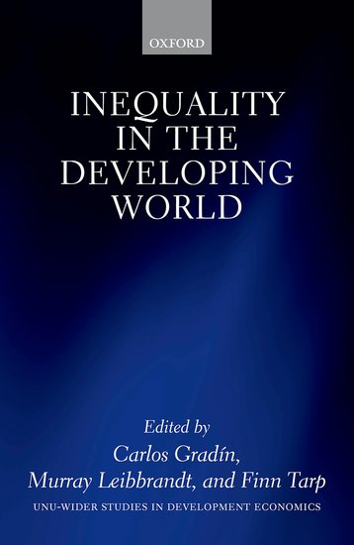
Inequality in the developing world
UNU-WIDER : Book, Open Access : Inequality in the Developing World

