Slide 1
Stockholm Statement
Towards a new consensus on the principles of policy-making for the contemporary world
Finn Tarp
Department of Economics
Faculty of Social Sciences
University of Copenhagen (UCPH)

Slide 2
Development Economics: 1945 to mid-1970s
World War II
World Bank + IMF
Foreign aid (multi + bilateral)
Regional development banks
Market failure and focus on the state
Import substitution + industrial policy
Neoclassical counter-revolution/market fundamentalism
International debt crisis and economic collapse

Slide 3
The Washington Consensus (WC) (John Williamson)
Ten broad sets of relatively specific policy recommendations:
Fiscal policy discipline, with avoidance of large fiscal deficits relative to GDP;
Redirection of public spending from subsidies ("especially indiscriminate subsidies") toward broad-based provision of key pro-growth, pro-poor services like primary education, primary health care and infrastructure investment;
Tax reform, broadening the tax base and adopting moderate marginal tax rates;
Interest rates that are market determined and positive (but moderate) in real terms;
Competitive exchange rates;
Trade liberalization: liberalization of imports, with particular emphasis on elimination of quantitative restrictions (licensing, etc.); any trade protection to be provided by low and relatively uniform tariffs;
Liberalization of inward foreign direct investment;
Privatization of state enterprises;
Deregulation: abolition of regulations that impede market entry or restrict competition, except for those justified on safety, environmental and consumer protection grounds, and prudential oversight of financial institutions;
Legal security for property rights.

Slide 4
1980s: A Lost Decade for Development (sub-Saharan Africa average annual change in pct 1980-89)
GDP per capita: -1.1
Gross domestic investment: -3.9
Merchandise exports: -0.6
Merchandise imports: -5.9
Inflation: 19.0
Terms of trade: -4.9
Long term debt outstanding: 14.5
Population growth: 3.2
Plus debt service (percent of GNP): 1.4 (1965), 3.1 (1980), 5.9 (1989)

Slide 5
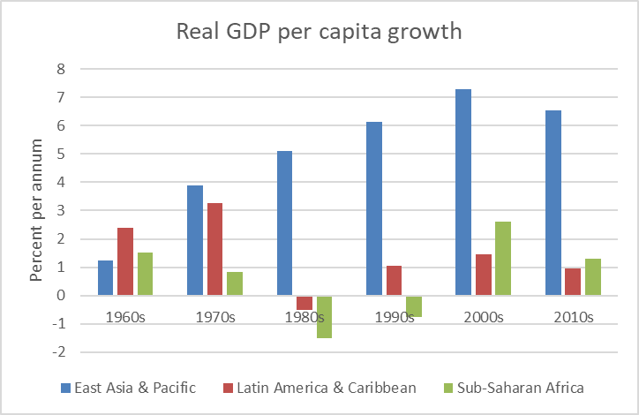
Post Washington Consensus Developments
What happened?
https://www.wider.unu.edu/sites/default/files/Publications/Working-paper/PDF/wp2017-169.pdf
Adjustment with a human face
Increasing focus on poverty and inequality
Gradual paradigm shifting

Slide 6
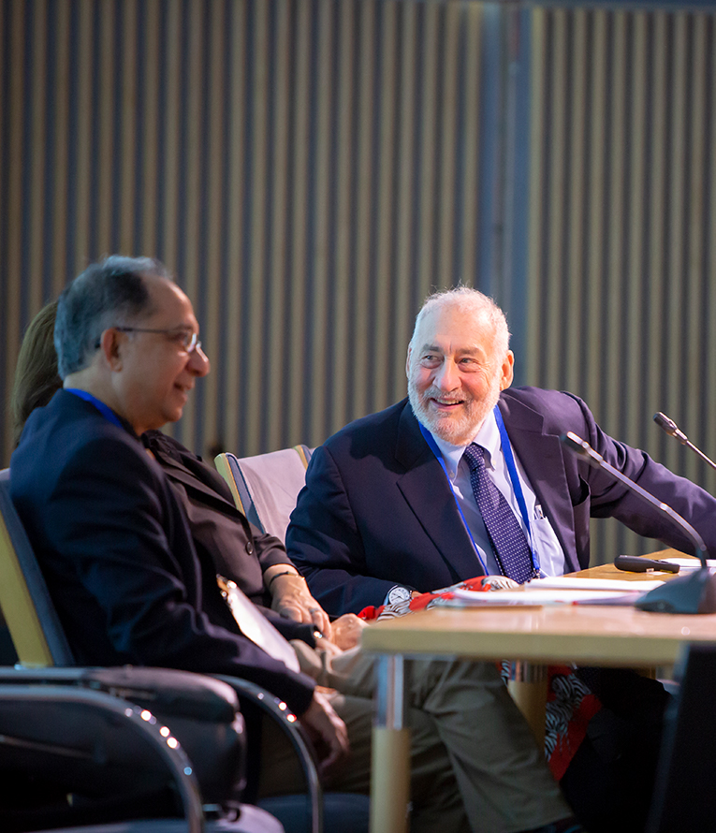
World Bank
Chief Economist Joseph Stiglitz (1997-2000)
Prof Kaushik Basu (2012-16)
Council of Eminent Persons (CEP)
A. Sen, J. Stiglitz, other former Chief
Economists, Eric Maskin, Esther Duflo,
Montek Ahluwalia and a few more
World Development Reports
What to do about the WC? Jim Yong Kim!
And what about the SDGs?

Slide 8
Saltsjöbaden
Thirteen economists, which included four former Chief Economists of the World Bank, met over two days at Saltsjöbaden, Sweden, on 16-17 September 2016, to discuss the challenges faced by today’s economic policy makers
The meeting was hosted by the Swedish International Development Agency SIDA and the World Bank

Slide 9
The Group
Sabina Alkire (Oxford)
Pranab Bardhan (Berkeley)
Kaushik Basu (New York)
Haroon Bhorat (Cape Town)
Francois Bourguignon (Paris)
Ashwini Deshpande (Delhi)
Ravi Kanbur (Ithaca)
Justin Yifu Lin (Beijing)
Kalle Moene (Oslo)
Jean-Philippe Platteau (Namur),
Jaime Saavedra (Lima)
Joseph Stiglitz (New York)
Finn Tarp (Helsinki and Copenhagen)

Slide 20
Conclusions
Traditional economic thinking no longer applies
Inequality within countries is threatening social cohesion and economic progress
Development needs to be seen in a broader perspective in order to achieve more equitable and sustainable results
Trickle down alone will not do the trick

Slide 21
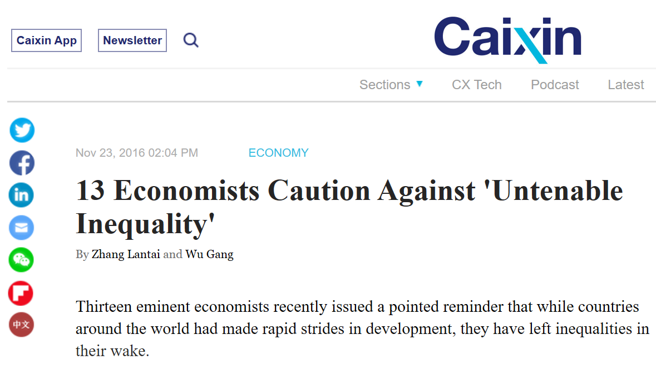
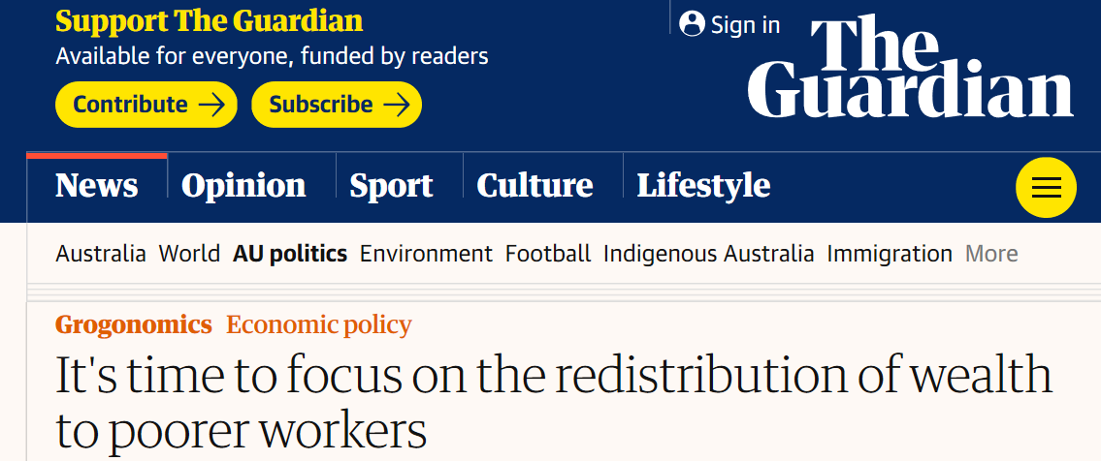
Outreach
Stockholm Statement translated into 22 languages, including African languages such as Amharic and Kiswahili
Since the release of the Stockholm Statement in late 2016, different media outlets around the world have reported on the principles

