Slide 1
Window 1 research collaboration projects General Conditions for grant management and project implementation
Danida Fellowship Centre
9 April 2019

Slide 2
Agenda
General conditions for grant management and project implementation
Time | Topic | Responsible
10:00-10:15 | Welcome and introductions | Lars Arne Jensen and Ida Arendal Jørgensen
10:15-10:45 | General conditions and good practices | Lars Arne Jensen and Ida Arendal Jørgensen
10:45-11:00 | Stays of researchers in Denmark | Eva Thaulow
11:00-11:30 | Audits and accounts | Anne Christensen
11:30-11:45 | Research communication and good stories | Lars Arne Jensen and Ida Arendal Jørgensen
11:45-12:00 | Final comments and questions | All
12:00-13:00 | Lunch | DFC

Slide 3
W1 projects granted in 2018
Project coordinator | Institution | Project Title | Country(ies) | Link to project in Danida Resarch Portal
Faith Philemon Mabiki | Sokoine University of Agriculture, Tanzania | Green Resources Innovations for Livelihood Improvement | Tanzania | http://drp.dfcentre.com/project/green-resources-innovations-livelihood-improvement
Iben Nathan | University of Copenhagen | Rights and Resilience in Kenya (RARE) | Kenya | http://drp.dfcentre.com/project/rights-and-resilience-kenya-rare
Peter Sanful | University of Energy and Natural Resources, Ghana | Building Resilience of Lake Busumtwi to Climate Change | Ghana | http://drp.dfcentre.com/project/building-resilience-lake-bosumtwi-climate-change
Ole Wæver | University of Copenhagen | Militarisation, sustainable growth and peace in Uganda | Uganda | Pending
Thilde Langevang | Copenhagen Business School | Advancing Creative Industries for Development in Ghana | Ghana | http://drp.dfcentre.com/project/advancing-creative-industries-development-ghana
Nauja Kleist | Danish Institute for International Studies | Diaspora Humanitarianism in Complex Crises (D-Hum) | Somalia and Kenya | http://drp.dfcentre.com/project/diaspora-humanitarianism-complex-crises-d-hum
Finn Tarp | University of Copenhagen | Building Resilience to Climate Change in Ethiopia | Ethiopia | http://drp.dfcentre.com/project/building-resilience-climate-change-ethiopia
Dan Meyrowitsch | University of Copenhagen | Enabling best possible child birth care in Tanzania | Tanzania | http://drp.dfcentre.com/project/enabling-best-possible-childbirth-care-tanzania
Neil Webster | Danish Institute for International Studies | Governing Climate Mobility (GCM) | Ethiopia and Ghana | http://drp.dfcentre.com/project/governing-climate-mobility-gcm
Lars Engberg-Pedersen | Danish Institute of International Studies | Global Norms and Violence Against Women in Ethiopia | Ethiopia | http://drp.dfcentre.com/project/global-norms-and-violence-against-women-ethiopia
Ester Barinaga | Copenhagen Business School | Grassroots Innovations for Inclusive Economic Growth | Kenya | http://drp.dfcentre.com/project/grassroots-innovations-inclusive-economic-growth
Lisa Ann Richey | Copenhagen Business School | Everyday Humanitarianism in Tanzania (EveryHumanTZ) | Tanzania | http://drp.dfcentre.com/project/everyday-humanitarianism-tanzania-everyhumantz
Emmanuel Obuobie | CSIR-Water Research Institute, Ghana | Building climate-resilience into basin water management | Ghana | http://drp.dfcentre.com/project/building-climate-resilience-basin-water-management
Boateng Kyereh | Kwame Nkrumah University of Science and Technology (KNUST), Ghana | Access-Authority Nexus in Farmer-Herder Conflicts | Ghana | http://drp.dfcentre.com/project/access-authority-nexus-farmer-herder-conflicts
Nsubili Isaga Mwalukasa | Mzumbe University, Tanzania | Crowdfunding for Youth Entrepreneurship in Tanzania | Tanzania | http://drp.dfcentre.com/project/crowdfunding-youth-entrepreneurship-tanzania
Daniel Adjei-Boateng | Kwame Nkrumah University of Science and Tecnology (KNUST), Ghana | Increasing the Productivity of Ghanaian Aquaculture | Ghana | http://drp.dfcentre.com/project/increasing-productivity-ghanian-aquaculture

Slide 4
Good practice
Act in accordance with principles of good admin practice:
Transparency
timely, reliable, and relevant information/documentation
Accountability
be able to account for decisions and actions taken
Effectiveness
administration facilitates project implementation in the best possible way
Efficiency
project funds are used appropriately to achieve project outputs
And - act in accordance with the General Conditions and follow the relevant rules and regulations of the institution in question
Notes:
LAJ

Slide 5
Conditions available on the DFC Website
Notes:
LAJ

Slide 6
Content of the General Conditions
A set of requirements and procedures to be followed by projects (budgeting, reporting, presentation of accounts, auditing, etc.)
Non-compliance can lead to close down of project and return of funds
The conditions are updated yearly
Appendices - format for disbursement request, link to reporting formats (e-fond), audit instructions, template for partnership agreement, etc.
Notes:
LAJ

Slide 7
Role of Project Coordinator
The grant is awarded to the Responsible Institution, not to the Project Coordinator.
On behalf of the Responsible institution the Project Coordinator must ensure that the project is implemented as approved
…and ensure
An equal partnership
Coordination among partners
Proper financial management by all
Rules and regulations are respected
Ethical approvals and permits in place
Compliance with MFA’s anti-corruption policy
Etc.
Notes:
IAJ

Slide 8
Partnership Agreement
The Partnership Agreement must be entered within the first half year - the second disbursement to the project is conditional on submission to DFC
How the project will be organised
Distribution of responsibilities
How to resolve disagreements
How the project will be implemented and concluded
Etc.
Appendix 9 provides a template
Notes:
IAJ

Slide 9
Partnership
Successful research partnerships are based on reciprocity, trust, and mutual respect.
Set aside sufficient time and resources for project planning and management on both sides, as well as for building management capacities.
Set aside sufficient time and resources for effective communication and sharing of information.
Ensure an explicit decision-making process and transparency in all stages of project planning and management.
Notes:
IAJ

Slide 10
Terms and conditions for salary
Salaries for staff must follow tariffs of the institution in question
Top-up on salaries, double salaries, or payment of consultancy fees is not accepted
Salaries are either compensation/ replacement salary or compensation payment for over-time, either hourly or performance based
In the case of over-time payment, a written agreement must be entered between the institution and the researcher
Payment of salary or remuneration must be declared to the tax authorities
Duty travel settlement must follow institution’s regulations but not exceed Danish rates
The participating institutions are responsible for insurance of project personnel
Notes:
IAJ – Difference in rules and norms for DK and south partners. Replacement salaries generally not used in south.

Slide 11
Reporting
Reports must be mutually agreed among all project partners
The deadline is 1 July for the first-year and midterm report
The deadline for submission of the completion report is six months after the approved completion date
Use appendix 1, 2 and 3 - links to electronic online (e-fond) reporting plus appendices
There may be special requirements attached to the response to reports – submit a revised/extra first-year or midterm report within a DFC defined deadline
Notes:
LAJ

Slide 12
Project Management Cycle
Action point | Timing
Signing the Letter of Grant. | Upon receiving Letter of Grant.
Send 1st disbursement request for first year’s activities. | The 1st disbursement request should be sent to DFC with the signed Letter of Grant.
Partnership Agreement with all collaborating partners. | Must be sent to DFC within 6 months after project start – second transfer of project funds is conditional on the partnership agreement.
Disbursement request for future instalments. | December 2019 onwards.
Transfer of 1st instalments of future instalments. | Dec. 2019/Jan. 2020 onwards.
Accounts (incl. external audit of all South partners). | Annual Accounts: 01 July on an annual basis. Final Accounts: 6 months after project end date.
Narrative Reporting | The deadline is 01 July for the first-year and midterm report. First Year Report – 01 July 2020. Midterm Report – 01 July 2022/2023 depending on project duration. Completion Report – 6 months after project end date. Extra midterm report is required if project is no-cost extended for more than 12 months.
Midterm review | After 2-2½ year of activities.
All relevant project management information can be found at DFC website: http://dfcentre.com/wp-content/uploads/2018/01/General-Conditions-2018.pdf
Notes:
LAJ

Slide 13
Quality assurance
Reports are assessed by DFC for formal requirements, management, and partnership
DFC also assesses whether the reporting incl. LogFrame is sufficiently detailed to assess the quality of the progress towards approved objectives, outcomes and outputs
DFC may ask Project Coordinators for additional information or details
The progress and results conveyed in all three types of reports will be further assessed by the Consultative Research Committee for Development Research (the FFU)
All project coordinators will receive a response to the reports upon completion of the FFU assessment
Notes:
LAJ

Slide 14
Administration of fellows in DK
By Eva Thaulow Nielsen
What do we do?
Assistance with application for residence permit or Schengen visa
Insurance (DFC needs information about health condition)
Flight reservations via CWT in the Ministry of Foreign Affairs
Accommodation (in Copenhagen area only)
Bank account and payment of monthly allowances
Registration at the International Citizen Service Centre (ICS)
Application for tax exemption
Counselling on personal and family matters
Social activities (www.fellowship-post.com)

Slide 15
What do we need from you?
3 months’ notice (please call DFC for coordination of study dates).
Copy of the letter of invitation (you will find a draft letter at our web site: www.dfcentre.com).
Copy of the passport (page with names and date of birth).
E-mail address and address of the university of the fellow.

Slide 16
What are the costs (in 2019)?
Allowances: DKK 1,700 per week per fellow.
Accommodation: DKK 1,400 per week per fellow.
Air ticket (budget figure): DKK 9,000 per trip (the actual expense will be invoiced).
Payment for residence permit (if applicable): DKK 1,900 each renewal (also in case of extensions).
DFC administration (incl. Insurance, counselling, social and cultural activities etc.): NIL.
Allow for an annual increase of app. 2.5% on all the budget figures above.
NB: The expenses incurred by DFC are not subject to overhead.

Slide 17
Can we take care of senior researchers’ stay in Denmark (e.g. post docs)?
Yes, the allowance rate is still DKK 1,700 per week per fellow and the flight ticket budget figure is still 9,000 but the accommodation rate for staying at DFC is DKK 325 per night (DKK 250 per night for stays over 30 days).
Over and above the mentioned budget figures for accommodation, allowance, air ticket etc., DFC charges an administration fee of DKK 6,000 per senior researcher.

Slide 18
Accounts and audit
By Anne Christensen
The Danish responsible institution has the overall responsibility for ensuring that adequate accounts are kept and financial procedures are in place - also at partner institutions
Accounting records and materials must be keep for 5 years after project completion
In the event of misuse of funds, any loss must be borne by the Danish Responsible Institution

Slide 19
Annual accounts
The fiscal year is January 1 – December 31
The accounts (including partners’ accounts) must be submitted by e-mail to DFC at research@dfcentre.dk
The deadline for submission of the annual accounts is July 1
Accounts form Appendix 5 must be used
The maximum amount to be used for audits is DKK 30,000 per year and DKK 50,000 for the final audit. The funds for audit are earmarked. Additional expenses will not be accepted, but must be borne by the institution’s OH. The audit is not subject to OH

Slide 20
Annual audit - https://dfcentre.com/research/general-conditions-and-forms-for-research-projects-2/
Where the responsibility rests with the National Audit Office of Denmark
Audit of annual accounts for the Danish Responsible Institution is not required
A Management Endorsement, Appendix 6, must be submitted with the accounts, confirming the receipt of the partner institutions’ audited accounts, and that the auditors’ endorsement is without qualifications
Partner institutions’ annual accounts must be audited by an external auditor as per audit instructions Appendix 7
Other Danish institutions
The annual accounts must be audited as per audit instructions Appendix 7

Slide 21
Final accounts
The accounts must be submitted by e-mail to DFC research@dfcentre.dk
the deadline for submission of the final audited set of project accounts is six months after the approved completion date
Any deviations on individual budget lines exceeding 10% between the total originally approved budget and the final accounts must be explained, and – when exceeding 10% - the approval by DFC must be quoted
Any interest earned must be declared separately in the final accounts and returned to DFC

Slide 22
Final audit
Where the audit responsibility rests with the National Audit Office of Denmark
For the Danish Responsible Institution for which the actual audit is directly carried out by personnel of the National Audit Office, a Management Endorsement, Appendix 6, must be submitted with the accounts.
For the Danish Responsible Institution for which the actual audit is carried out by an external auditor designated to do so by the National Audit Office the full set of final accounts must be audited by an external auditor as per audit instruction Appendix 7.
Partner institutions’ final accounts must be audited as per audit instructions Appendix 7
Other Danish institutions
The final accounts must be audited as per audit instructions Appendix 7

Slide 23
Research communication and good stories
By DFC
MFA funded research must be accessible to the public
It must be clearly stated that the grant is awarded by the Ministry of Foreign Affairs of Denmark. With the following statement: The research results are independent, and the views and opinions expressed by project partners based on the research findings, do not necessarily reflect those of the MFA
The English /Danish designations are: Ministry of Foreign Affairs of Denmark /Udenrigsministeriet
When the Ministry of Foreign Affairs of Denmark is mentioned on the website, presentations, brochures, etc. please use the official logos: Download the logos here: https://um.papirfly.com/portal
Notes:
LAJ

Slide 24
Other acknowledgement
Acknowledgement in PowerPoints and other forms of documentation:
Fx: This work is (partly) funded by the Ministry of Foreign Affairs of Denmark and administered by Danida Fellowship Centre.
Everyone can use the following text about the Danida Fellowship Center: Fx: Danida Fellowship Centre administers Denmark’s support to development research and research capacity building on behalf of Ministry of Foreign Affairs of Denmark.
Work in progress to create a ”banner” with both UM logo and DFC Logo….
§ 15, Page 16-17-18 in the General Conditions: www.dfcentre.com

Slide 25
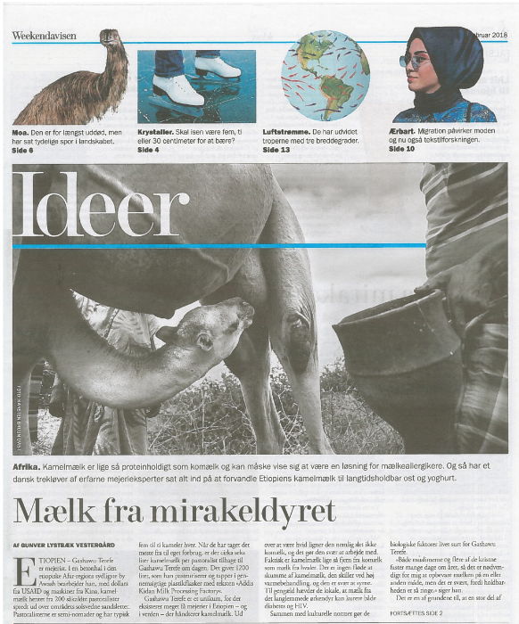
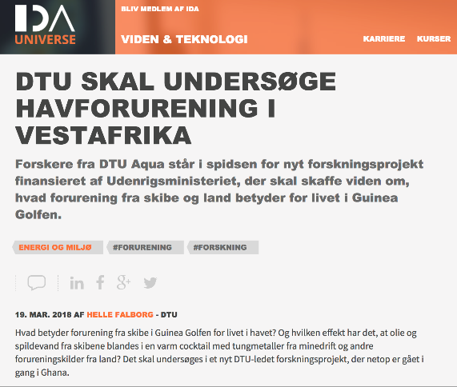
Publication of research results
Publication of research results in open access journals is encouraged
List of publications is part of the midterm and completion reporting
Policy Briefs with key recommendations to policy makers and other stakeholders is part of the completion reporting
Instruction for Policy Briefs is available as an appendix to the completion report
Notes:
List of publications: Direkte udsprunget af projektet Policy briefs: Vigtigst at de bliver brugt, fremfor antallet af briefs. For at sikre stakeholder involvering hele vejen igennem. Medtage centrale stakeholders fra starten til ”bestilling” af hvilke briefs de vil finde brugbare som resultat af projektet. God hjælp hele vejen igennem.

Slide 26
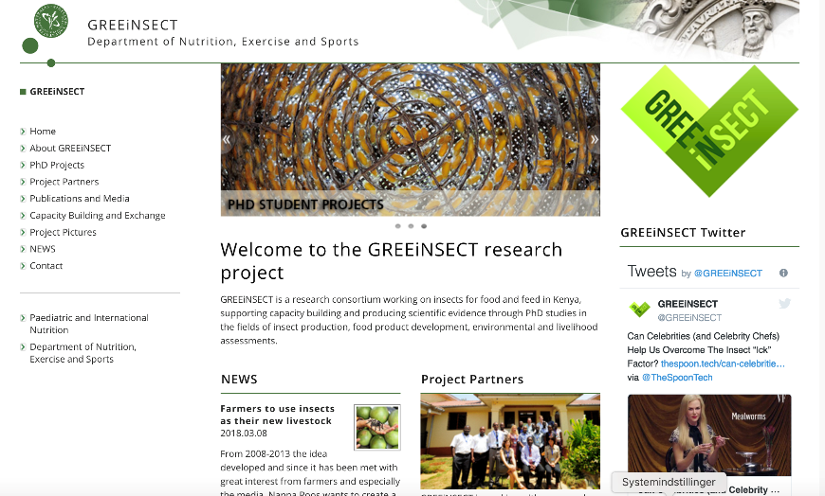
Web based information & Danida Research Portal
Link to web based information about the project must be provided in the first year report
A project website or for example an open Facebook page must include basic project information, achievements, links to publications and public presentations, proceedings of meetings, etc.
The website, Facebook page etc. must be available up to 5 years after the completion of the project
DFC makes information about the project available and updated at the Danida Research Portal, http://drp.dfcentre.com/

Slide 27
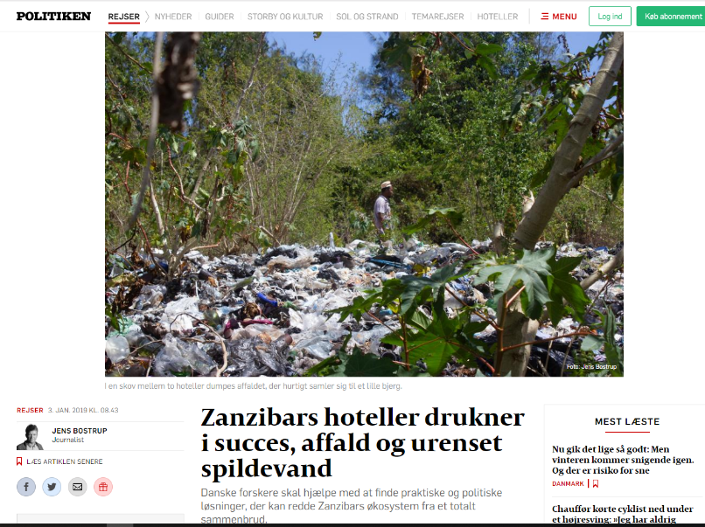
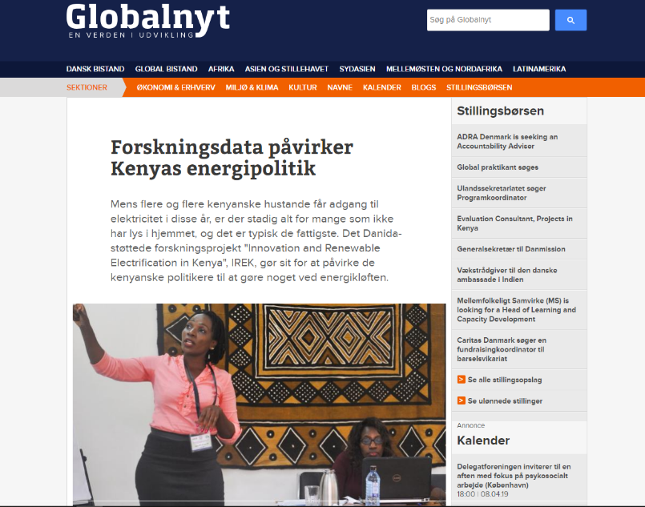
Help to communicate research results and stories
DFC contributes to research project communication using the following communications platforms
The Danida Fellowship Centre website
Quarterly newsletter
Facebook – LIKE & FOLLOW
LinkedIn - FOLLOW
Twitter - FOLLOW @DFC_Fellowship
External media
YOU ARE VERY WELCOME TO TAG US and CONNECT US W/COMMS DEPARTMENTS
All Project Coordinators should forward newsletters, and relevant articles, video, and photo material from the projects to research@dfcentre.dk
Video by DFC Communications department
Notes:
Jakob – viser video

Slide 28
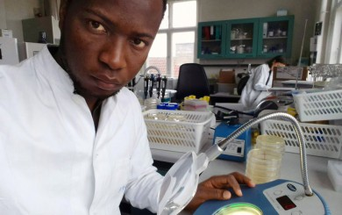
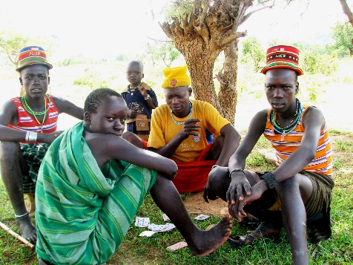
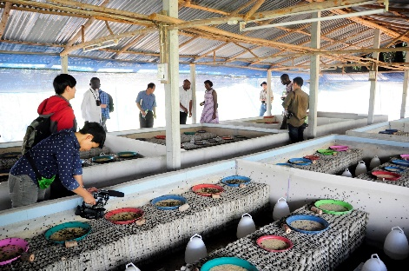
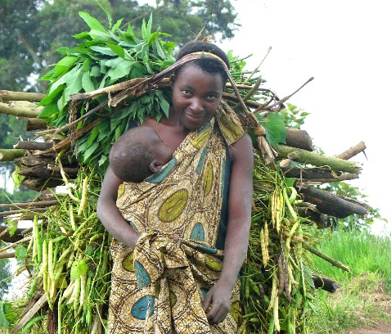
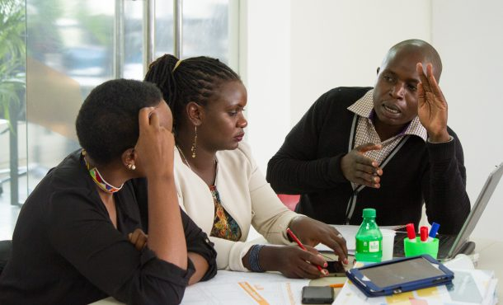
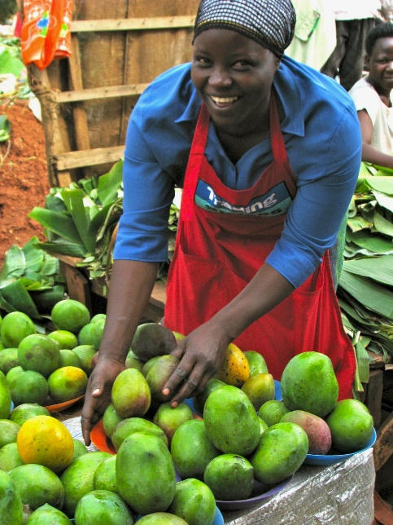
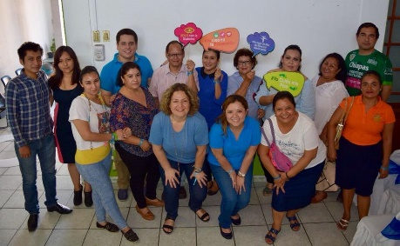
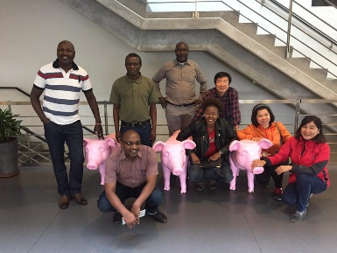
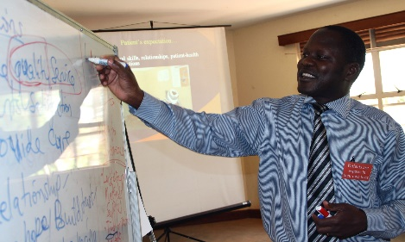
The good stories & photos
Good stories are part of the
reporting to DFC, see the ex. page 17 in General Conditions
The story should be brief and written in a popular scientific manner
It may be a story from the research partnership, a special achievement and/or impact of the project, successful outreach to stakeholders (users, policy makers, private sector, others), a workshop or a conference, or a field trip
Photos!
NO
NO

Slide 29
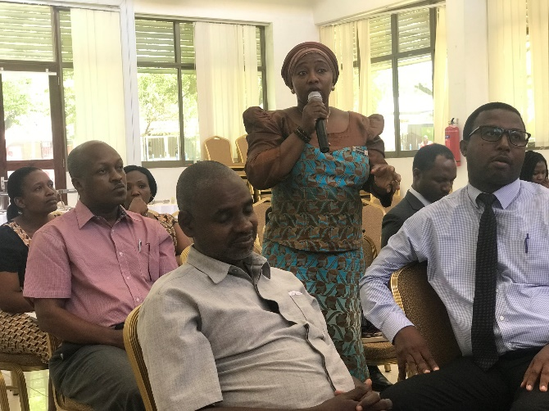
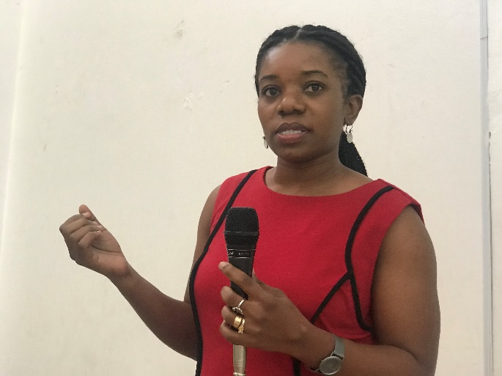
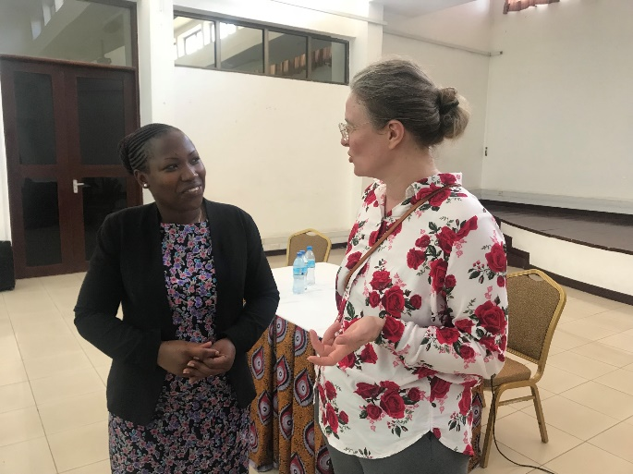
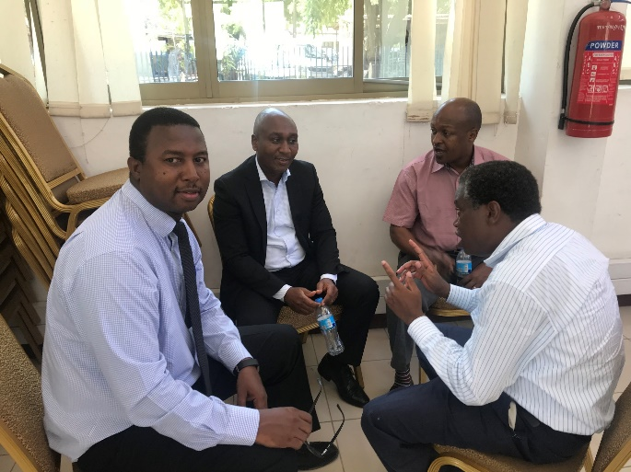
Co-organisation of workshops or conferences
Ongoing projects within the same research theme are encouraged to co-organise workshops and conferences targeting a broader group of stakeholders, possibly with a regional focus
It is possible to apply to DFC for extra funding (supplementary funds) to organize such events and report from them!

Slide 30
Thank you!
Reach us on:
research@dfcentre.dk

