Slide 1
Development Economics Research Group (DERG)
INTRODUCTION
Finn Tarp
Department of Economics
Faculty of Social Sciences
University of Copenhagen (UCPH)

Slide 2
Who We are and What We do?
Founded in 1996, DERG is a group of development economists based at the Department of Economics—sometimes out-posted in developing countries or international organisations
DERG includes 25 staff at all academic levels from research assistants to professors
DERG is coordinated by Finn Tarp, John Rand and Henrik Hansen
DERG members teach and train, and engage in research, policy and practice in development economics in Denmark and partner countries
DERG depends on external funding for our activities

Slide 3
Research, Policy and Practice
We work at the nexus of research, policy and practice and strive to stimulate ideas, subjecting them to in-depth analysis, generating evidence, mobilizing action and building capacity
We contribute to the strategy of the University of Copenhagen (UCPH) in the shared search for solutions to complex global challenges as articulated in the UN Sustainable Development Goals (SDGs) approved by the UN General Assembly in September 2015

Slide 4
Teaching and Training
DERG staff are responsible for a range of regular BSc and MSc courses in Economics at the Department of Economics:
BSc level
Development economics
MSc level
Advanced development economics – Macro aspects
Advanced development economics – Micro aspects
To this comes supervision of Bachelor and Master’s theses as well as PhD supervision and the running of regular economic seminar series.
Importantly, DERG staff support the Faculty of Social Sciences MSc in Global Development

Slide 5
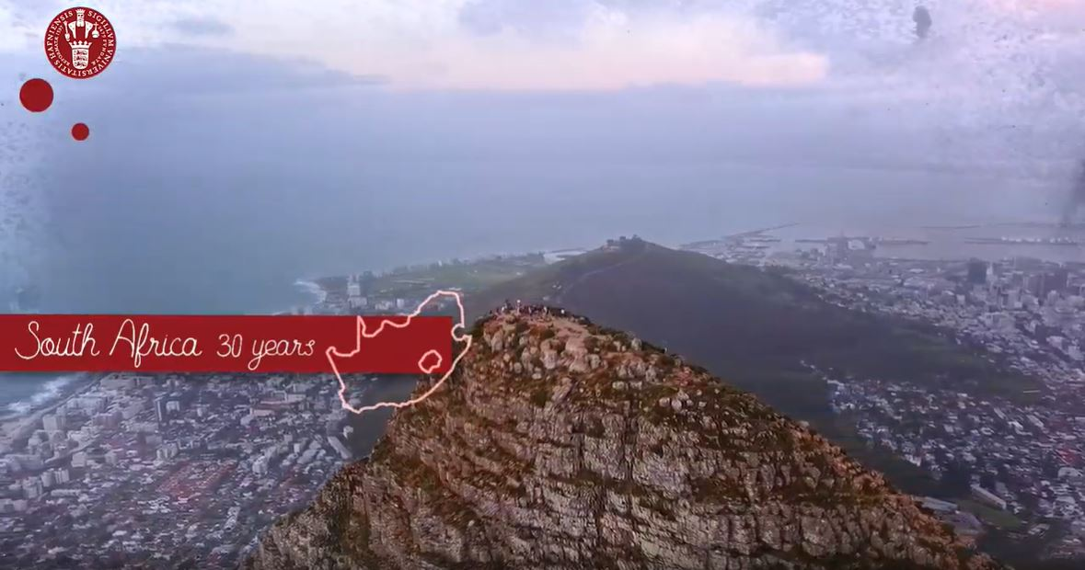
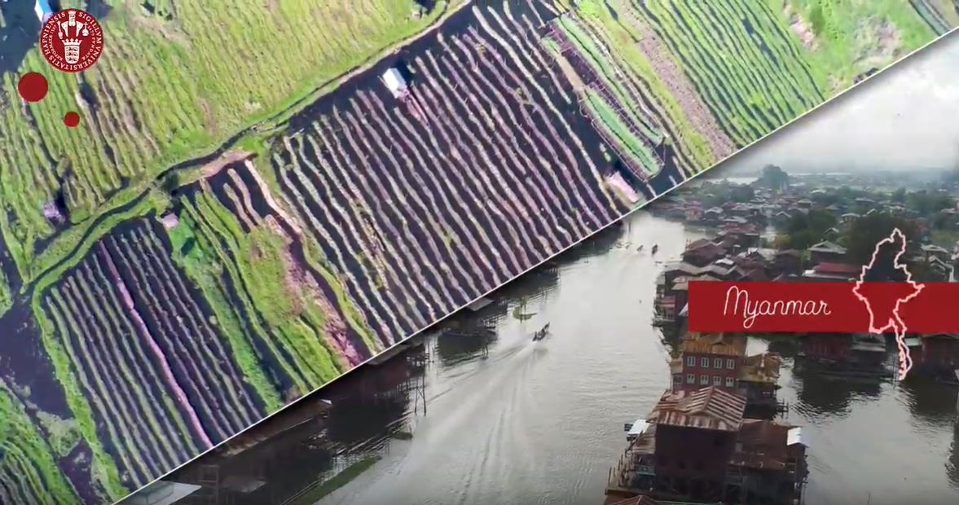
Country/Long Term Partnerships

Slide 6
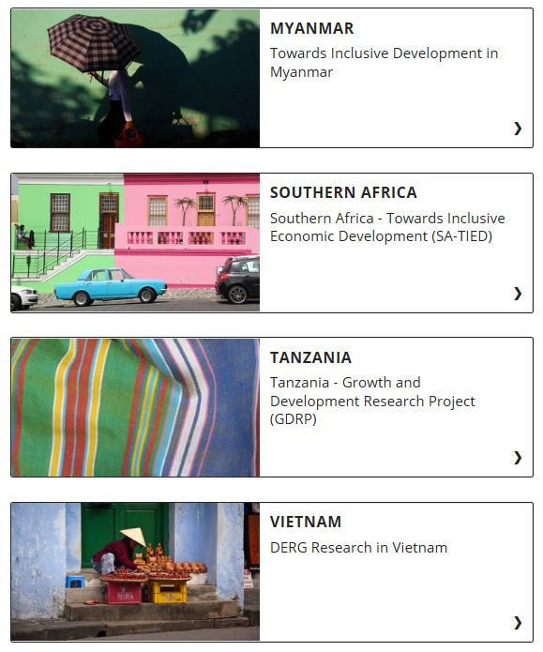
Current Research Projects

Slide 8
www.econ.ku.dk/derg
#DERGDK
@DERG__DK
@DERG_DK
/dergdk
DERG YouTube Channel

