Slide 1
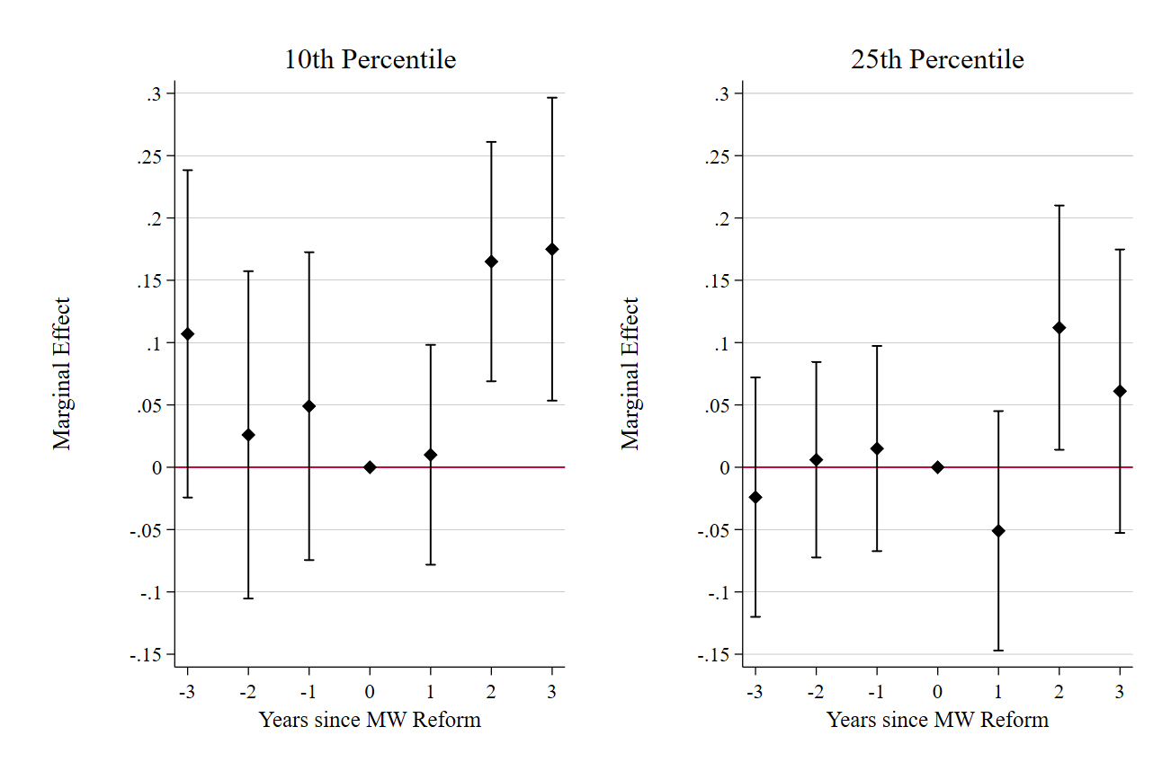
Minimum wages increase wage expectations of unemployed job seekers at the bottom of the distribution.

