Slide 1
The drivers, implications and outlook for inflation
Thomas Harr, Assistant Governor and Head of Economic and Monetary Policy, Denmark’s Nationalbank 2 November 2022

Slide 2
Agenda
Where are we now?..................................................................p.3
Why are we here?.....................................................................p.4
Where are we heading …………………………………………….p.11
A special focus on DK ……………………………………………..p.17
Implications for economic policy…………………………………p.23
Comparison to the 1970s……..................................................p.25
Conclusion…………………………………………………………….p.31

Slide 3
Where are we now?
Inflation in services contributes most to US inflation
Energy is the largest driver in the euro area…
… and in Denmark
Note: CPI and HICP decomposed with growth contribution. Data is from September.
Source: Macrobond.

Slide 4
Why – 1) The recovery was much faster than from previous crises due to the nature of the crisis.. (Theory: Phillips curve - both level and change in output gap matters, possible non-linarity)
USA, GDP
Euro area, GDP
Denmark, GDP
Note: The time period for the recession are defined by NBER.
Note: The time period for the recession are defined by OECD.
Note: The time period for the recession are defined by OECD.
Source: Macrobond.
Source: Macrobond.
Source: Macrobond.

Slide 5
Why – 2) …. And due to monetary and fiscal stimuli particularly in the US (Wicksellian theories and fiscal inflation)
Large drop in the policy rates in the US at the start of the pandemic
Very expansionary fiscal policy, particularly in the US
Note: A negative value indicates that fiscal policy is accommodative compared to 2019. Structural balance based on OECD June Economic outlook for the US and euro area. Structural balance for Denmark is based on the Danish Ministry of Finance’s ”Økonomisk redegørelse” from August 2022.
Source: OECD, Danish Ministry of Finance and own calculations.
Source: Macrobond.
Notes:
Kraftigt fald i de pengepolitiske renter i USA i begyndelsen af pandemien
Kraftig finanspolitisk stimulans, især i USA (strukturel saldo i % af BNP)

Slide 6
Why 2) continued – which have supported strong goods consumption in the US and Denmark (demand-pull inflation)
Strong demand for goods after the initial shock
Note: Real consumption. Euro area is a weighted average of Germany, France, Italy and the Netherlands, where weights are the share of total GDP of the respective country.
Source: Macrobond and own calculations.

Slide 7
Why 3) – Supply disruptions in the US labour market and in goods markets (global economy at steeper end of aggregate supply curve)
The participation rate is still below pre-pandemic levels in the US, but higher in European countries…
… while supply chain disruptions were particularly an issue during 2020 and 2021
Source: Macrobond.
Note: The index is normalized such that a value near zero indicates that the index is at its mean value, where positive values represent how many standard deviations the index is above its mean value (and negative values represent the contrary).
Source: Macrobond.

Slide 8
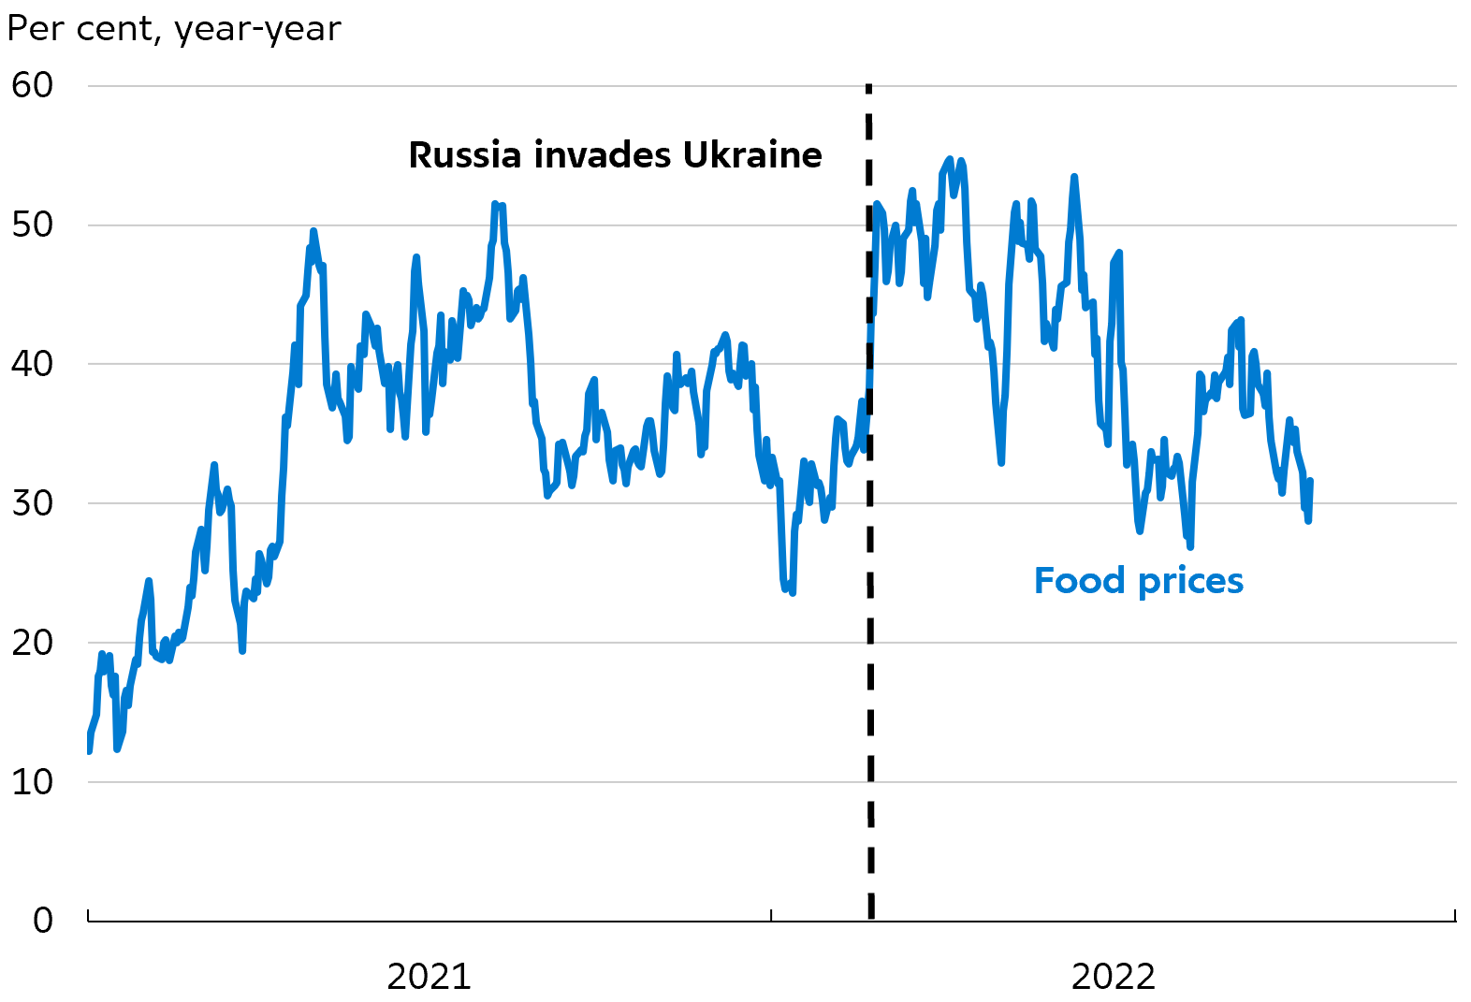
Why – 4) Energy and food prices have risen sharply through 2021 and 2022 (cost-push inflation)
European energy prices have risen very sharply during 2021 and 2022
The price increases of food are very high
Note: The price of electricity refers to the average price on Nordpool, the price of gas is based on TFF-Natural gas and the price of oil is USD per Barrel, calculated as a 14-days moving average.
Note: Food index frrom Hamburg Institute of International Economics (HWWI).
Source: Macrobond and own calculations.
Source: Macrobond.
Notes:
Kraftigt stigende priser på energi globalt er en central drivkraft bag den høje inflation
Under pandemien første fase medførte usikkerhed og nedlukning af produktion betydelige fald i priserne på energi og råvarer.
Genåbningerne af økonomierne og den markante stigning i global efterspørgsel førte højere priser på energi og råvarer.
Kombineret med en træg udvikling i udbuddet af energi førte det til væsentlige stigninger i energipriserne igennem 2021.
Ruslands invasion af Ukraine har løftet priserne på energi og andre råvarer yderligere. Det afspejler bl.a. Ruslands position som en væsentlig producent og eksportør af energiråvarer til især Europa. Siden foråret har lavere leverancer og usikkerhed om fremtidig forsyning af energi fra Rusland derfor ramt de europæiske energimarkeder særligt hårdt.
Dertil har høje temperaturer, begrænset nedbør og vind også påvirket energiproduktionen i Europa henover sommeren.
Bl.a. har lave vandstande og vedligehold af vandkræftværkerne reduceret produktionen af el fra Norge.
Mindre blæst end normalt har reduceret elproduktionen fra danske vindmøller.
Lave vandstande i tyske floder har vanskeliggjort transporten af bl.a. kul og reduceret produktionen af el fra tyske kulkraftværker
Høje vandtemperature i Frankrig har perioder gjort det nødvendigt at reducere produktion af energi fra atomkraft.
Samlet har det betydet, at elproduktion med gas i større grad end normalt har været nødvendig for at dækker el-efterspørgslen, og derfor har været bestemmende for elpriserne.
Priserne på energi råvarer bestemmes generelt på globale markeder
Individuelt kan de enkelte lande ikke reducere global efterspørgsel. Nødvendigt med koordinering.
Høje priser på energi og råvarer smitter af på priserne på øvrige varer og tjenester
Energi anvendes i produktionen af mange andre varer og tjenester. De høje energipriser har derfor en afsmittende effekt på priserne på disse varer og tjenester.
Gennemslaget kommer dog typisk med en vis forsinkelse og afhænger af virksomhedernes mulighed for og villighed til at lade de stigende produktionsomkostninger gå videre til forbrugerne eller at reducere deres profitmargener.
Amerikanske virksomheders enhedsprofitter er øget mærkbart siden 2021, hvilket peger på, at den stigende inflation på verdensplan bl.a. er et resultat af, virksomhederne under ét har været i stand til at hæve deres profitmargener.

Slide 9
Supply- and demand shocks across countries and sectors help explain the aggregate high inflation
Inflation in durable goods consumption is now similar across the three economies
Inflation in services is increasing in all three economies
Source: Macrobond.
Source: Macrobond.
Notes:
Inflationen i varige forbrugsgoder er højere i USA, men den er stigende i euroområdet og Danmark
Inflationen i tjenesteydelser er stigende i alle tre økonomier

Slide 10
High US wage growth underlines service price inflation; EUR and DKK depreciation supports imported inflation
Wage growth is still significantly higher in the US than in the Euro area and Denmark
The euro has weakened sharply against USD and in trade-weighted terms
Note: Data from Dansk Arbejdsgiverforening is used for Denmark, ECB’s negotiated wage indicator is used for the Euro area, and the employment cost index is used for the US.
Source: Macrobond.
Source: Macrobond.

Slide 11
Where are we heading – 1) Lower growth will weaken disposable incomes and employment weighing on demand (Phillips curve and demand-pull inflation)
Note: The growth rate for the US and euro area is based on Bloomberg consensus. The forecast for Denmark is based on Danmarks Nationalbank’s own forecast.
Source: Bloomberg and Denmark’s Nationalbank.

Slide 12
Where are we heading – 2) Fiscal policy is set to tighten in the US and Denmark but is still expansionary in the euro area (fiscal inflation)
Fiscal policy in the euro area is still expansionary…
… which amongst others is due to the funding allocated to shield households and firms from the rising energy prices
Note: Data of the structural balance for France, Germany and Italy is from the European Commission. Data for the US is from OECD, and data for Denmark is from the Danish Ministry of Finance’s ”Økonomisk Redegørelse”, August 2022.
Note: Data covers the period until 20 October 2022.
Source: Bruegel.
Source: Macrobond, European Commission, OECD and Danish Ministry of Finance.

Slide 13
Where are we heading – 3) Fed and ECB have used multiple tools to tighten monetary policy over the last year (Wicksellian theories and monetary policy shocks)
Significant rate hikes from the Federal Reserve and ECB since March and the market expects further hikes in the near future
Fed and ECB influenced the markets prior to the rate hikes
Note: Dotted lines indicate the implicit market expectations to policy rates in the US and euro area.
Source: Macrobond and Scanrate Rio.
Source: Macrobond.

Slide 14
Where are we heading – 3 cont) Large rate hikes from Fed and ECB, also from a historical perspective (Wicksellian theories and monetary policy shocks)
The pace of Fed’s rate hikes is the fastest since the 1970s
ECB has not previously increased their rates this fast
Note: Market expectations to Federal Funds rate per October 26th. Source: Macrobond and own calculations.
Note: Periods with rate hikes for respectively Bundesbank and ECB (Bundesbank for the two earliest periods).
Dotted black curve represents the implicit market expectations to ECB’s future deposit facility rate per October 26th 2022 based on the Euro-OIS-forward curve. The period in the end 1970s reflects the first period of rate hikes.
Source: Macrobond, Thomson Reuters, Scanrate Rio and Denmark’s Nationalbank.
.

Slide 15
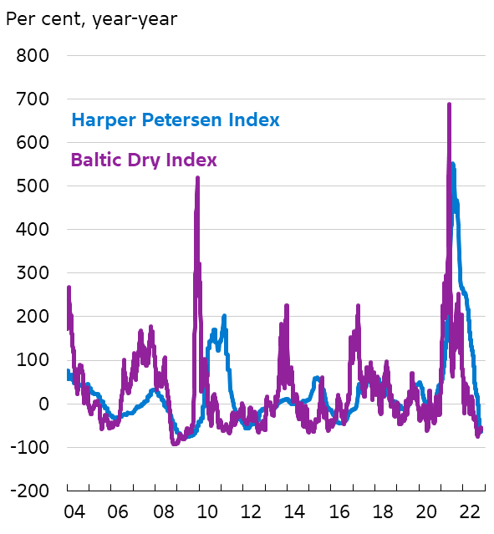
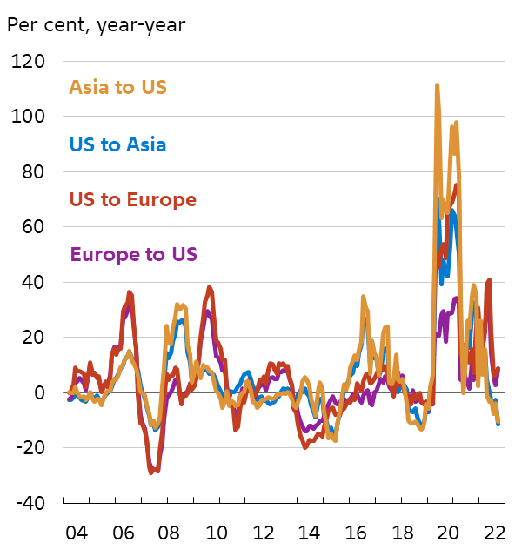
Where are we heading 4) - Global supply chains are improving (global economy at less steep end of aggregate supply curve)
Growth of container shipping rates has fallen recently
Delivery times have improved
Inflation in air freight prices have dropped recently
Note: Note: Delivery times are constructed via PMI. Delivery times have been inverted such that readings above 50 indicate longer delivery times.
Source: Macrobond.

Slide 16
Where are we heading 4) - Most evidence points to well-anchored long-term inflation expectations (Phillips curve)
The long-term inflation expectations are well-anchored
Households expect a relatively high inflation in 3 years in the US and Euro area
Note: The market-based inflation expectations are based on a 5y-5y inflation swap. The survey-based inflation expectations for the euro area reflect the expectations of inflation in 5 years in ECB’s Survey of Professional Forecasters, while the survey-based inflation expectation of the US reflects the expectations of inflation in the next 5-10 year in Fed’s Survey of Professional Forecasters.
.
Note: The chart shows the median of the survey-based houdshold expectations to inflation in 3 years.
Source: ECB, Federal Reserve Bank of New York and Macrobond.
Source: Refinitiv Eikon and Macrobond.

Slide 17
A special focus on DK: There are risks of inflation becoming entrenched due to the tight labour market and very high inflation
Households in Denmark expect significant inflation next year, but the september prognosis expects a relatively quick reduction
Wage growth is expected to rise to just below 5% in 2023, almost on par with wage growth in 2007
Note: Household questionnaire-based inflation expectations for the next 12 months weighted by the difference between actual and perceived inflation, i.e. that households which neither overestimate nor underestimate the actual price increases are given a higher weight. HICP inflation refers to the EU Harmonised Index of Consumer Prices.
Note: The forecasts for 2023 and 2024 are from Danmarks Nationalbank, Outlook for the Danish economy. The Wage numbers are from The Confederation of Danish employers.
Source: Macrobond.
Source: Statistics Denmark, Macrobond and own calculations

Slide 18
A special focus on DK: Why is inflation high in Denmark? A trend-cycle model
Energy is the primary driving force…
… but the trend has increased
Note: The sum of the contributions in the chart corresponds to the deviation of inflation from a trend, meaning that it is not identical to actual inflation. The chart is based on a trend-cycle model in which HICP inflation is decomposed into contributions from a trend, energy prices and capacity pressures measured via a Philips curve for the output gap for the Danish economy.
Source: Statistics Denmark and own calculations
Source: Statistics Denmark and own calculations.

Slide 19
A special focus on DK: Why is inflation high in Denmark? A trend-cycle model
Cyclical conditions are also pushing…
… via an active Philips curve
Source: Statistics Denmark and own calculations

Slide 20
A special focus on Denmark: Inflation is currently higher for low-income households
Differences in households’ consumption baskets….
… give rise to inflation differentials
Source: Statistics Denmark, own calculations and Weissert (2022), Essays in Macroeconomics: Inflation inequality, consumption baskets and impulse responses, PhD thesis, University of Copenhagen.
Note: For each income group, the chart is based on a Laspeyres price index calculated on the basis of the consumption in the period 2010-15 on the basis of microdata from Statistics Denmark’s consumer survey. The inflation differential is calculated relative to the 10 per cent with the highest income.
Source: Statistics Denmark, own calculations and Weissert (2022), Essays in Macroeconomics: Inflation inequality, consumption baskets and impulse responses, PhD thesis, University of Copenhagen.

Slide 21
A special focus on Denmark: Inflation will remain high in 2023, but will still be significantly less than this year
We expect inflation will remain very high during the winter, but fall during 2023
Sensitivity analysis shows that deviations in energy prices and new tariff agreement will have a significant effect on inflation
Source: OECD, Macrobond, Refinitiv Eikon and Denmark’s Nationalbank.
Source: Denmark’s Nationalbank.

Slide 22
The uncertainty is very high partly due to volatile energy prices
Gas and energy prices have fallen sharply since late August
Source: Macrobond and quarterly forecast of Nationalbanken from September.

Slide 23
Implications for economic policy
1) Government aid programmes which compensates specific groups due to high energy- and food prices should not increase economic activity and therefore capacity pressures in the economy
2) Subsidies and tax reductions implemented to reduce effects from high energy prices should be avoided, as they will support consumption of energy
3) Targeted, temporary transfers are more appropiate than subsidies and tax cuts, although repeated payments reduce incentives to shift away from expensive energy sources
4) Policy measures should not distort prices such that incentives to dampen energy consumption are preserved

Slide 24
Implications for economic policy
The Danish labour market is very tight. At the same time, inflation is at its highest in 40 years
Most evidence suggests that medium- to long-term inflation expectations are well-anchored around 2 per cent
However, inflation expectations are very hard to measure accurately. The longer time inflation remains high while labour markets are tight, the higher is the risk that inflation expectations de-anchor and inflation becomes entrenched.
To lean against this risk, we have recommended that fiscal policy for the coming year should be tighter than what the government has currently proposed.

Slide 25
Comparison to the 1970s – current inflation is around the average in the 1970s in the US and Denmark, but much lower than the peak
Inflation in US is slightly higher than the mean level in the 1970s
Inflation in Italy is lower than in the 1970s
The inflation in Denmark is slightly above the mean level in the 1970s
Source: OECD and Macrobond.

Slide 26
Similarities to the 1970s – energy and food price shocks….
The oil price has increased substantially as in the 1970s
… and the same applies for food and wheat
Note: Crude oil price, USD per Barrel, spot Brent.
Note: The Wheat index is from S&P GSCI, Wheat index.
Source: OECD, Macrobond.
Source: S&P, HWWI, OECD and Macrobond.

Slide 27
Differences to the 1970s – but the nature of the energy shock is different
…but gas prices have increased more compared to the 1970’s
Note: Index of average world price. Yearly series until 1975.
Source: World Bank and Macrobond.

Slide 28
Differences to the 1970s – more independent monetary policy regimes
USA:
Fed’s independence was weakened during Nixon/Burns (cf. Bernanke, 2022)
Politicians and Fed had a non-monetary, cost-push view on inflation with limited capacity for monetary policy
Today, the current government respects Fed’s independence
Today, Fed believes that inflation can be controlled in the medium run by monetary policy
Euro area:
Through the 1970s, the Bundesbank had a large degree of independence, while the central banks in France, Italy and Spain were much less independent (cf. Bernhard, 1998).
Today, ECB sees price stability as its primary mandate, and ECB’s independence is determined by the institutional frame through the treaty and the statute.
Denmark:
Through the 1970s and the early 1980s monetary stability was lost in Denmark. Policy mistakes contributed to a sharp increase in inflation and consecutive governments resorted to devaluating DKK.
This changed after the shift to a fixed exchange rate regime in 1982.
Today there is a high degree of credibility concerning the fixed exchange rate and economic policies in general.
Source: Bernanke (2022), Bernhand (1998).

Slide 29
Differences to the 1970s – the medium-term inflation expectations are more well-anchored
Meidum-term inflations expectations were de-anchored in the end of the 1970s in the US, which is different today
Note: The chart shows survey-based inflation expectations from University of Michigan’s consumer survey.
Source: Macrobond and own calculations.

Slide 30
Differences to the 1970s – Lower propagation of wage indexation but high inflation creates risk of a wage-price spiral
Government program ”Dyrtidsregulering” nourished a wage-price spiral in Denmark through the 1970s in Denmark
Wages react stronger to rising prices when inflation is high
Note: ”Dyrtidsregulering” was a programme regulating wages and some public services automatically in accordance with inflation.
Note: A high inflation regime is a period with inflation above 3 pct. Pass-through is estimated via a regression model, where wage growth in industry is explained by inflation, unemployment gap, and the productivity growth the year before 1st quarter 1985 – 2nd quarter 2022.
Source: Macrobond, Danmarks Nationalbank, Statistics Denmark and own calculations.
Source: Macrobond, Danmarks Nationalbank, Statistics Denmark and own calculations.

Slide 31
Conclusion
1) There are significant differences between inflation in the US, the euro area and Denmark
Services is the dominant factor in US inflation
Energy is the most important factor in the euro area and Denmark but food prices are also important
2) Why are we here?
The nature of the crisis, the US fiscal boost, supply disruptions and the energy shock are key drivers.
Currently, supply disruptions are centered around energy in Europe and the labour market in the US.
3) Where are we heading?
Weaker global growth, tighter monetary policy, improving conditions for global goods supply and well-anchored inflation expectations suggest inflation will head lower in coming years.
4) A special focus on Denmark
High inflation is primarily due to energy, but cyclical factors also play a role due to an upward sloping Phillips curve
Lower energy prices and tariffs pose downside risk to our 2023 forecasts but upside risks to our 2024 forecasts
5) Implications for economic policy To lean against the risk that inflation expectations de-anchor and inflation becomes entrenched, we recommend that fiscal policy should be tightened.
6) There are major differences to the 1970s Centralbanks are more independent, inflation expectations are more well-anchored and there are lower propagations of wage indexation

Slide 32
Thank you

Slide 33
References
Bernanke, Ben (2022), 21st Century Monetary Policy – The Federal Reserve from the Great Inflation to Covid-19, W. W. Norton & Company.
Bernhard, William (1998), A political explanation of Variations in Central Bank Independence, The Americal Political Science Review.
Danmarks Nationalbank (2022), Outlook for the Danish Economy – the Pressure on the Economy Should be Eased, September 2022.

